Slide 1



Clinical SOP Assistant
A Local RAG System for Clinical Trial SOPs.
Presented By,
Nithyashri Murali
2026 - https://www.agilisium.com

Slide 2
The Complexity of Clinical Trials
Regulatory Backbone: Clinical trials are governed by extensive SOPs that define every operational and compliance activity.
Critical Stakes: These procedures are essential to ensure patient safety, data integrity, and regulatory adherence.
Document Density: SOPs are notoriously lengthy, often reaching hundreds of pages of technical requirements.
Operational Friction: Site staff often struggle to navigate these documents quickly during active trial phases.
The Need for Speed: Instant access to precise procedural guidance is a requirement for modern, efficient clinical research.
2026 - https://www.agilisium.com

Slide 3
Problem Statement
Clinical trial Standard Operating Procedures (SOPs) are governed by extensive documents that define every operational and compliance-related activity. These SOPs are critical to ensure patient safety, regulatory compliance, and data integrity. However, their extreme length (often hundreds of pages), complexity, and technical nature make it difficult for investigators and site staff to quickly locate precise operational guidance when it is needed most.
As a result, manual search processes are inefficient, leading to repetitive support queries, increased dependency on support teams, and significant operational delays. Furthermore, the difficulty in navigating these dense documents creates a higher risk of incorrect SOP interpretation or procedural deviations, ultimately impacting trial efficiency and jeopardizing regulatory compliance.
2026 - https://www.agilisium.com

Slide 4
Strategic Solution
Core Innovation: A local AI-powered RAG system designed for instant, SOP-grounded answers.
Procedural Fidelity: The system generates responses strictly based on approved procedural content.
Semantic Intelligence: It retrieves the most relevant SOP sections based on intent, not just keywords.
Data Privacy: Operates entirely within a local environment to ensure total data sovereignty.
Decision Support: Provides a reliable "digital assistant" to investigators for real-time decision making
2026 - https://www.agilisium.com

Slide 5
Why Existing Search Methods Fail
Keyword Limitations: Traditional search misses semantic meaning and fails when users paraphrase.
Manual Navigation: Tools like "PDF Find" require investigators to have prior knowledge of document structure.
The Hallucination Gap: General AI chatbots often invent facts (hallucinate) when they lack specific grounding.
Security Concerns: Centralized LLM APIs pose significant risks regarding data privacy and regulatory standards.
Grounding Necessity: Clinical domains require every answer to be backed by retrieved, verifiable content.
2026 - https://www.agilisium.com

Slide 6
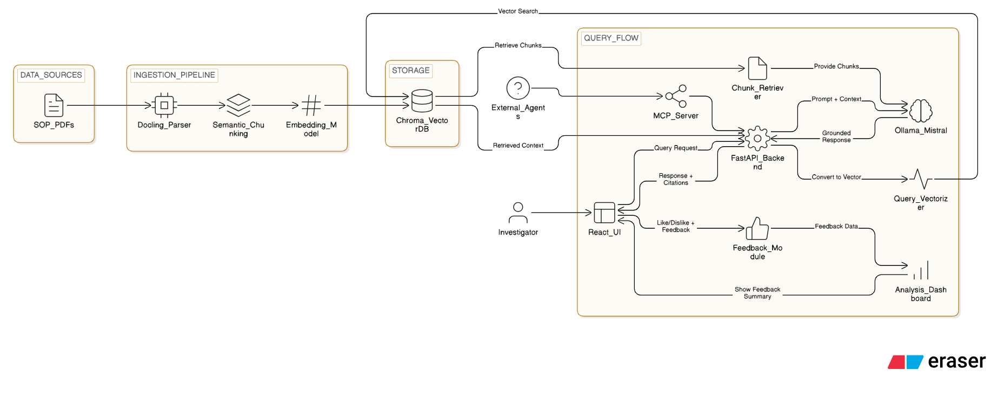
High-Level System Architecture
2026 - https://www.agilisium.com

Slide 7
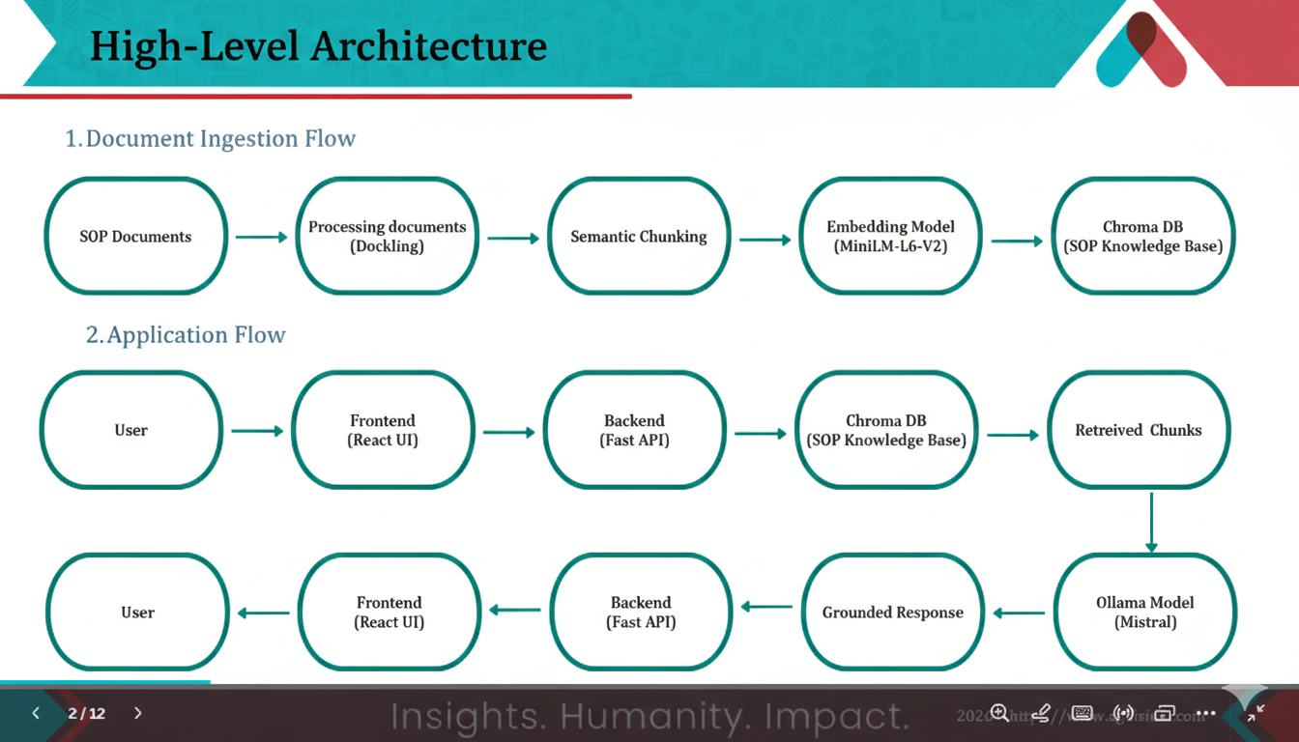
Flow Diagram
2026 - https://www.agilisium.com

Slide 8
The Document Ingestion Pipeline
Structured Text Extraction: Uses Docling to parse PDFs while preserving layout and table structures. In my project, I have ingested real time SOP PDFs from a Medical Datacenter.
Vectorization: Employs the all-MiniLM-L6-v2 model for fast and memory-efficient embeddings.
Vector Storage: Chunks and embeddings are stored in ChromaDB for rapid semantic retrieval.
Persistent Knowledge: Unlike basic FAISS setups, ChromaDB ensures the SOP knowledge base is persisted.
Batch Processing: Supports uploading and indexing multiple SOPs to build a comprehensive knowledge service.
2026 - https://www.agilisium.com

Slide 9
Semantic Chunking
A structure-aware data processing strategy that bypasses traditional fixed-token splitting to divide SOP text based on logical headers and procedural sections.
Operational Impact: By maintaining configuration limits between 300 and 2500 tokens, the system ensures context continuity and provides the LLM with complete instructional units, eliminating "truncated text" hallucinations and preserving the integrity of complex clinical procedures.
Vector Similarity
The use of Cosine Similarity to mathematically measure the semantic relationship between investigator queries and stored SOP chunks within a high-dimensional vector space.
Technical Advantage: This metric focuses on the "semantic direction" of intent rather than raw word count or magnitude, providing a significant accuracy boost by effectively ignoring text length differences to prevent the irrelevant results often associated with Euclidean distance.
2026 - https://www.agilisium.com

Slide 10
Local Inference with Ollama & Mistral
On-Premise Generation: Uses Ollama to run the Mistral model locally, ensuring zero data leakage.
Grounded Prompting: The model is strictly instructed to answer only using the retrieved SOP context.
Privacy-Native: Ideal for regulated environments where cloud-based AI is prohibited.
Natural Language Synthesis: Converts raw retrieved chunks into clear, actionable procedural guidance.
Resource Efficiency: Mistral provides high performance without requiring massive cloud compute costs.
2026 - https://www.agilisium.com

Slide 11
2. End-to-End Runtime Workflow
Query Embedding: The investigator's question is converted into a vector in real-time.
Semantic Search: ChromaDB identifies and retrieves the top-K relevant SOP fragments.
Context Assembly: Chunks are formatted into a structured prompt for the LLM.
Answer Synthesis: The LLM generates a grounded response, attaching confidence scores and citations.
User Interaction: The frontend displays the answer and collects feedback for continuous improvement.
2026 - https://www.agilisium.com

Slide 12
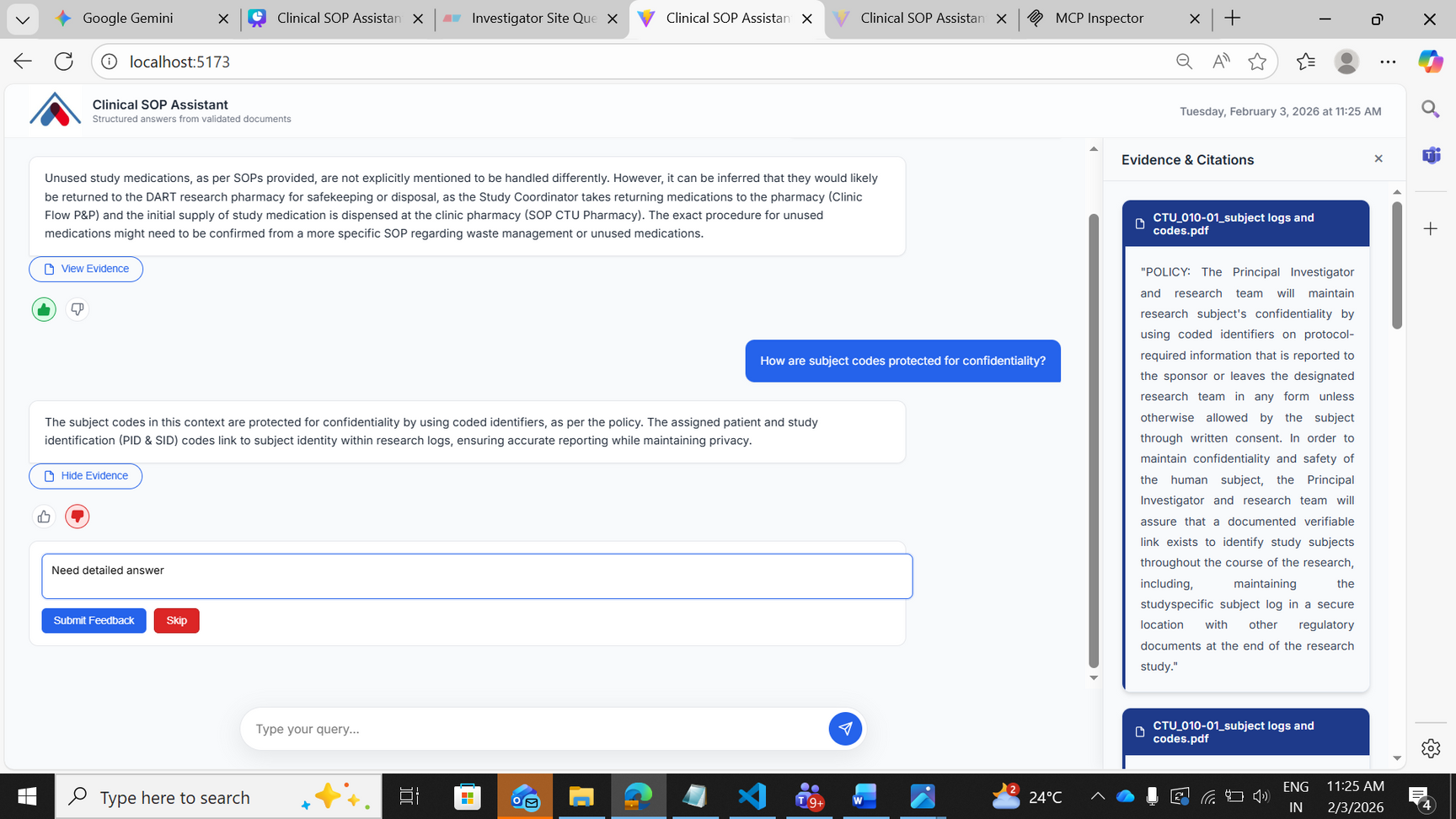
Clinical SOP Assistant UI
2026 - https://www.agilisium.com

Slide 13
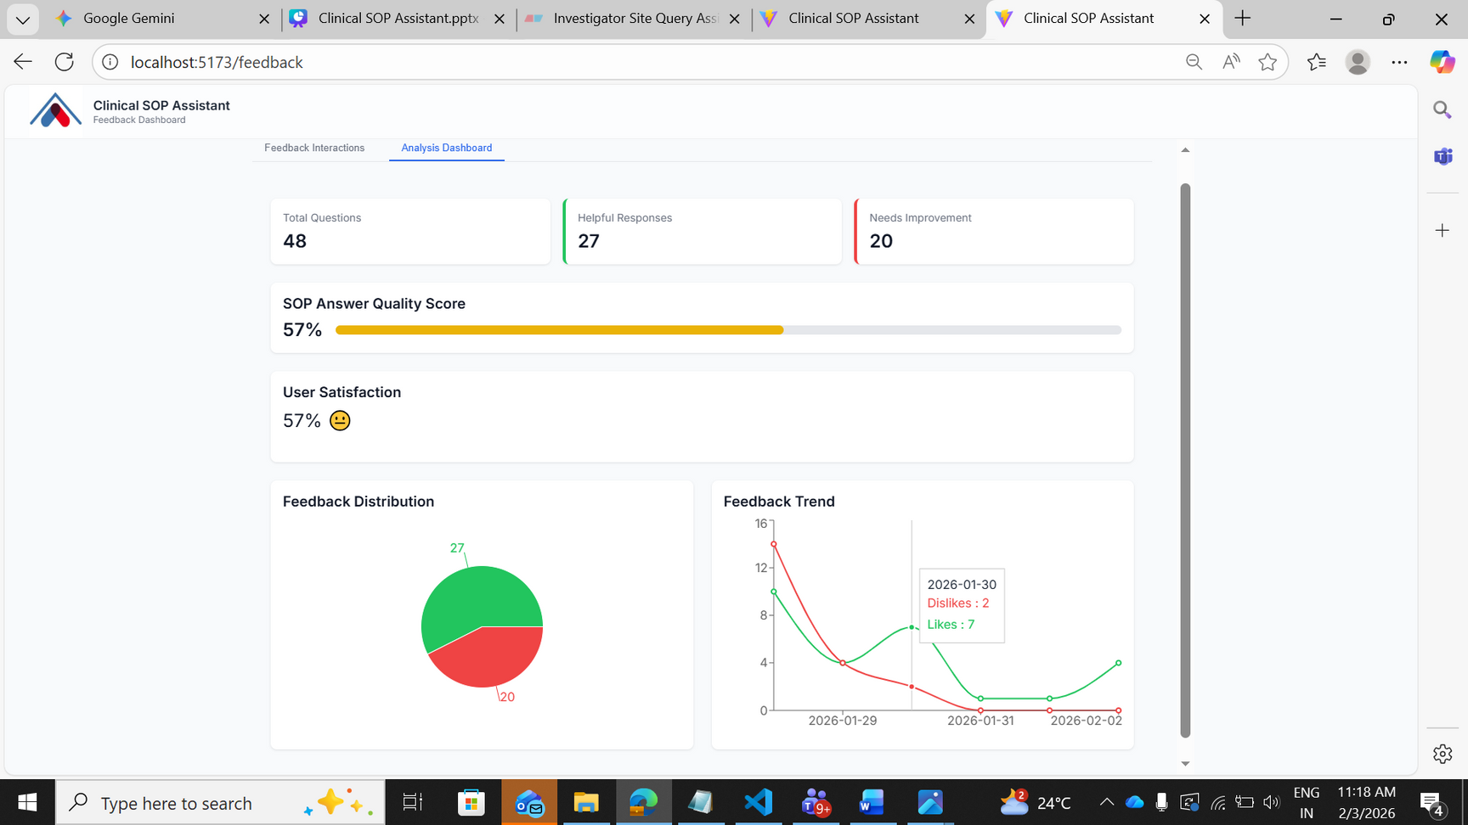
Feedback & Analytics Layer
2026 - https://www.agilisium.com

Slide 14
Interoperability via Model Context Protocol (MCP)
The Protocol: Implemented using FastMCP to create a standardized AI tool interface.
Agent Integration: Exposes search_clinical_sops, allowing other AI agents to query the system.
Vendor Lock-in Prevention: Ensures the system can communicate with any AI ecosystem that supports MCP.
Knowledge Service: Transforms a simple chatbot into a reusable knowledge utility for the organization.
Decoupled Interaction: External agents can use the SOP knowledge without needing direct database access.
2026 - https://www.agilisium.com

Slide 15
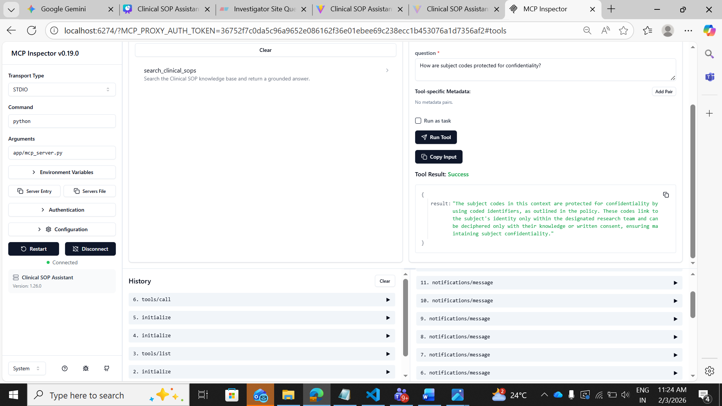
Testing MCP using MCP Inspector
2026 - https://www.agilisium.com

Slide 16
Results & Operational Impact
Performance: Achieved near-instant response times for complex procedural queries.
Accuracy: High retrieval precision ensures investigators get the right information the first time.
Support Reduction: Lowered the manual workload on clinical support teams significantly.
Accessibility: SOP guidance is now available 24/7 without waiting for a human coordinator.
Risk Mitigation: Reduced the probability of trial deviations through explainable, grounded AI.
2026 - https://www.agilisium.com

Slide 17
Conclusion
The Investigator Site Query Assistant bridges the gap between complex regulatory documentation and real-time operational needs using a secure, local RAG architecture. By integrating local LLMs with the Model Context Protocol (MCP), the system provides GxP-ready, grounded guidance that eliminates data leakage and AI hallucinations. This solution reduces administrative burdens while enhancing trial integrity and accelerating the delivery of compliant clinical research.
2026 - https://www.agilisium.com

Slide 18
Future Directions
Global Multilingual Support: Implementing cross-lingual embeddings to allow global sites to query SOPs in their native languages.
Workflow Integration: Developing direct APIs for Clinical Trial Management Systems (CTMS) to provide real-time procedural support.
Automated Compliance Auditing: Deploying analytics to automatically detect procedural gaps and contradictions across SOP versions.
2026 - https://www.agilisium.com

Slide 19


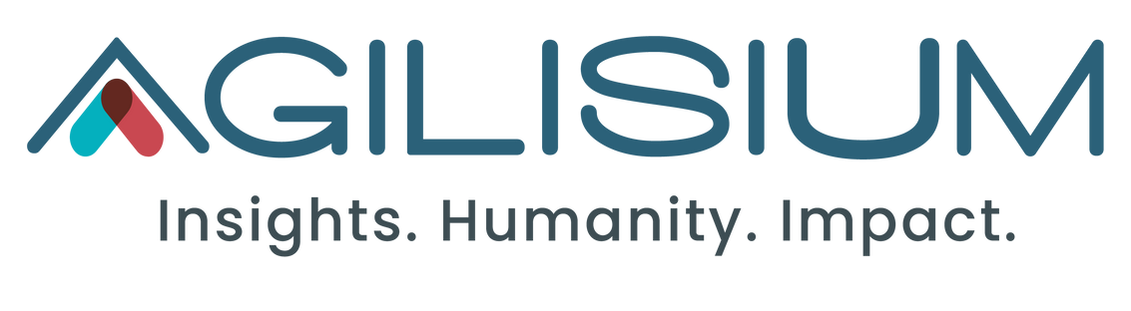
Thank You

